Slide 1
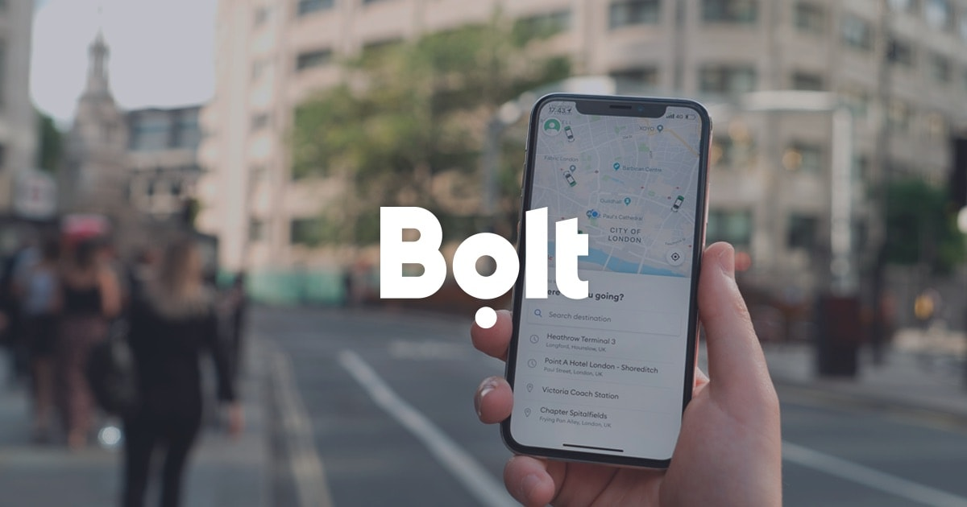
Assignment - Senior Strategy Analyst
Aditya Yadav

Slide 2
Introduction
Bolt business is acquiring new companies in different regions, through different channels and segments. (Given Acquisition Table)
Acquired business generate revenue by paying for the orders that they complete. (Rides, Food Deliveries or Scooters.) Given Order Table.
Next we look at how can we:
Optimize Acquisition Channels.
Enhance Regional Strategy.
Prioritize segments that generate most revenue.
Find Anomalies to see any significant drop in Revenue. (Qtr on Qtr)
Background
Objective

Slide 3
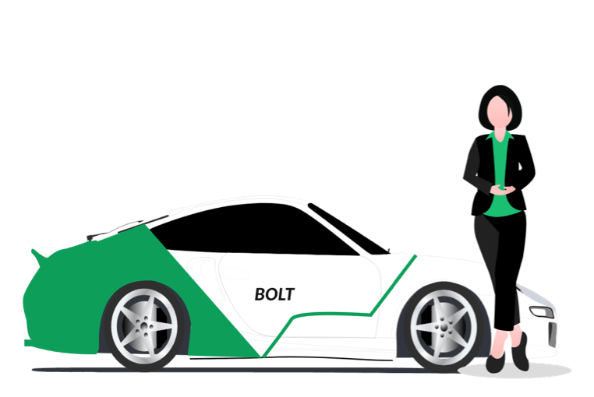
Calculations & Visualizations

Slide 4
Summary (Overview)
147 pp YoY growth (2023 vs 2022)
Avg QoQ Revenue growth : 42 pp.
3.8% new businesses Acquired in 2023 as compared to 2022.
Recommendation: Can increase spend depending on Budget and Cost.
Revenue Increase is in pp is in sync with Increase in Number of Orders and No. Of Active Companies across 2022 and 2023.
Revenue YoY Metric
Year | Revenue | Orders | Active Companies
2022 | 2.6 Mn | 0.49 Mn | 18k
2023 | 6.6 Mn (+ 146 pp) | 1.2 Mn (+147 %) | 42k (128 %)
2024 (Qtr 1)* | 1.2 Mn | 0.23 Mn | 8.4k
Forecasted 2024 | Same as 2023
* Data only up till March 2024.
2024 Qtr 1 Revenue is 2% higher as compared to 2023 Qtr 1 Revenue figures. Not including 2024 as part of YoY comparision.
Split | YoY Increase (Revenue)
Segment | T0 | T1 | T2 | T3 | T4
 | 31% | 132% | 190% | 176% | 79%
Channel | Marketing | Organic | Outreach
 | 117% | 87% | 177%
Region | Aquilonia | Lumina | Novaria | Seraphica | Solsticea | Valoria | Veridia
 | 56% | 258% | 262% | 871% | 86% | 112% | 151%
FYR Link to Gsheet: Data

Slide 5
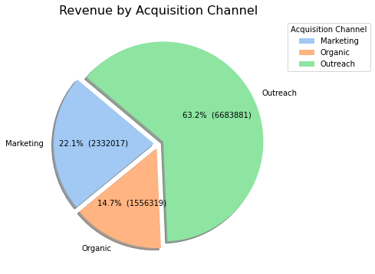
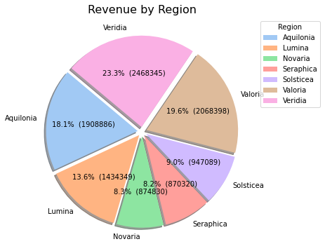
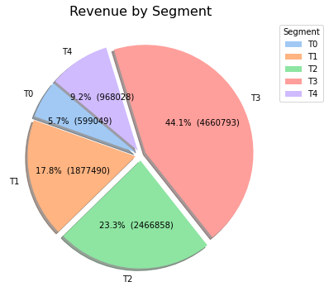
Companies Acquired via Outreach Channel have the highest share in revenue (63%) followed by Marketing and Organic.
T3 (44%) and T2 (23%) businesses combined have 67% revenue share.
Veridia has the highest share in Revenue (23 pp) whereas from the last slide Seraphica saw the highest growth in YoY Revenue.
Since Seraphica still has only 8.2% share in Revenue. There can be upside to capture market based on number of businesses in the region.

Slide 6
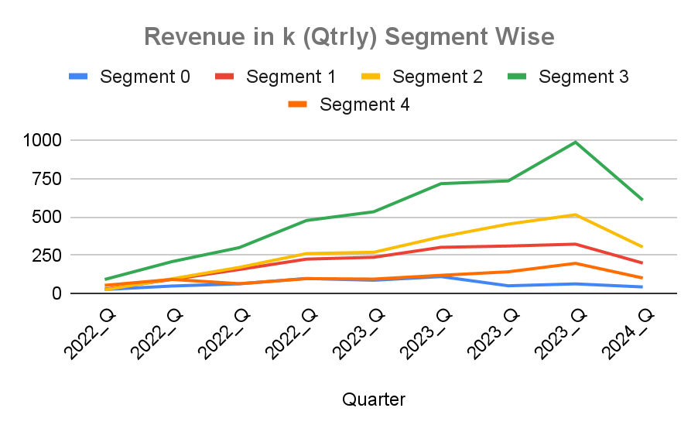
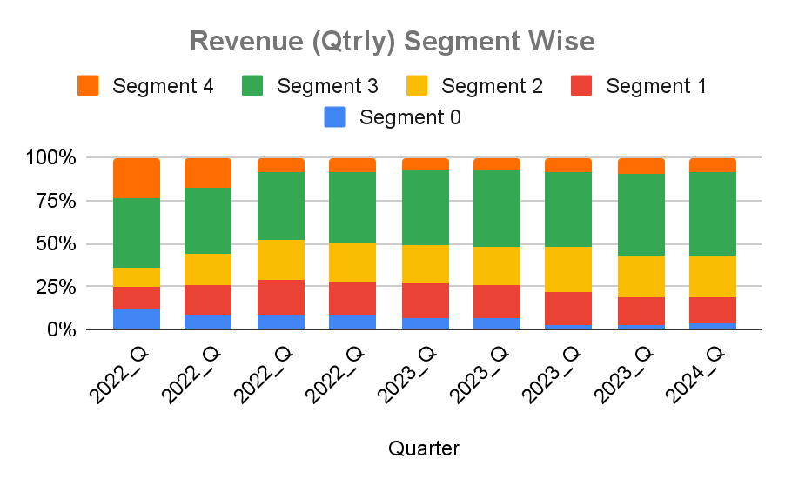
TRENDS: Segment
Bolt business experienced 147 pp Increase in Revenue in 2023 driven by T2 (189 pp) , T3 ( 175 pp), T1 (132 pp) segments.
T3 grew 175 pp YoY and in terms of Vol it commands 44 pp of Revenue share. This is followed by T2.
T4 and T0 saw decline in revenue share as can be observed in second Chart (Bottom Blue and Red Bar). Vol wise as well both segments have remained flat.
57pp of acquired businesses belonged to T4 segment. here followed by T3. Revenue per company for the T4 segment is the lowest at 43. Therefore we should focus more on T3 and T2 segment which showed more growth and at the same time look at any problems T4 businesses might be facing in terms of Revenue making.

Slide 7
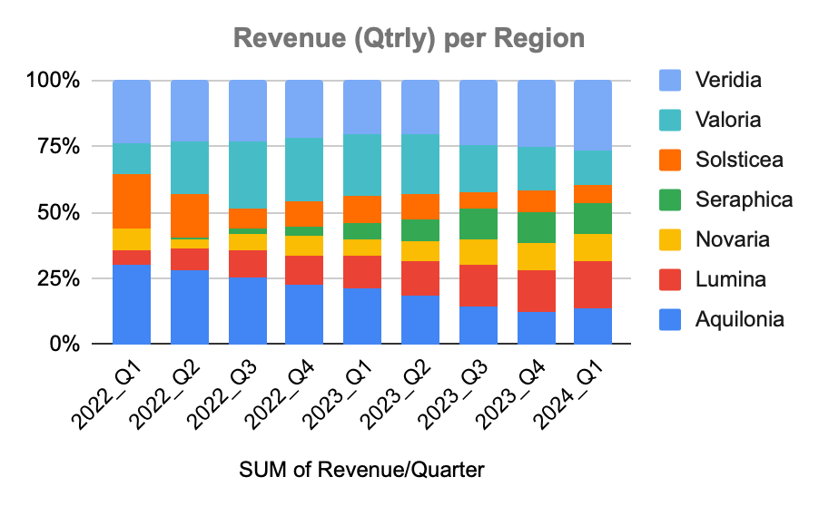
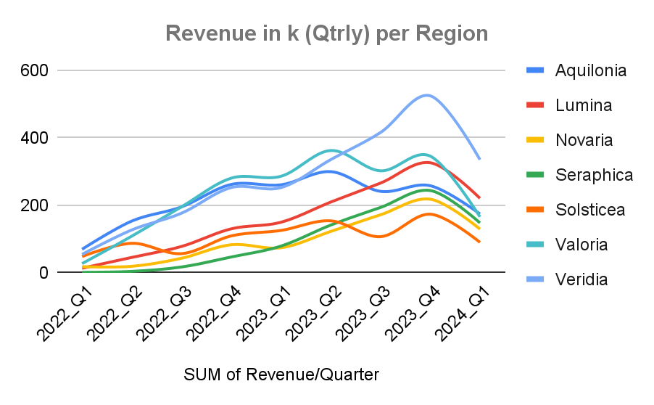
TRENDS: Region
From the Chart below, Seraphica Revenue Share has been increasing QoQ (Green). The Region also has the highest Revenue per Company (218) and high value orders (11).
Overall every Region saw increase in revenue with occasional drops in Quarter. (QoQ Region Wise: Anomalies)
Revenue Share increase: Regions [Seraphica, Lumina, Novaria]
Revenue Share Drop: Regions [Aquinolia, Solsticea, Valoria]

Slide 8
TRENDS: Region
From the Chart below, Seraphica Share has been increasing QoQ. The Region also has the highest Revenue per Company (218) and high value orders (11).
Overall focus should be on acquiring business with high Order per Company, $ per Order, $ per Company. Also to consider if any company is significantly higher in any one of factors. For e.g Aquilonia has lowest $ per order by highest Order per company. Seraphica performs good in all three areas with 11 $ per order, 217 $ per company and 20 order per company. But we only Acquired 7% in the region. Therefore Bolt can acquire more in this region. Other Region is Novaria, with similar profile as Aquilonia but only 5% companies were acquired here. Though this is dependent on the market cap and how many business are present in the city, also the acquisition cost.
Region | Revenue | Orders | Companies | $ Per Order | $ per Company | Order per Company | Acquired Companies | % Acquired Company
Aquilonia | 1908886 | 579209 | 10369 | 3 | 184 | 56 | 1710 | 15%
Lumina | 1434349 | 166649 | 11188 | 9 | 128 | 15 | 1852 | 17%
Novaria | 874830 | 226391 | 4509 | 4 | 194 | 50 | 603 | 5%
Seraphica | 870320 | 81388 | 4000 | 11 | 218 | 20 | 759 | 7%
Solsticea | 947090 | 60598 | 8065 | 16 | 117 | 8 | 1676 | 15%
Valoria | 2068398 | 518778 | 13368 | 4 | 155 | 39 | 1633 | 15%
Veridia | 2468345 | 313941 | 18011 | 8 | 137 | 17 | 2911 | 26%
Grand Total | 10572218 | 1946954 | 69510 | 5 | 152 | 28 | 11144 | 100%

Slide 9
TRENDS: Region (Aquilonia Specifically)
Aquilonia has the lowest revenue per order. But the market share in Revenue is 18%. Revenue per company was second highest 184 due to Vol of Orders. 15% of all companies acquired were from this city. Data.
So what can we do here: (Recommendations)
Focus on T0 and T1 segment in region with higher $ per company as compared to baseline 184 in the region.
Explore Adjusting Pricing to increase $ per order. If Possible
Segment | Total $ | Total Orders | Companies | $ per order | $ per company
T0 | 394073 | 94659 | 45 | 4 | 8757
T1 | 454402 | 161429 | 622 | 3 | 731
T2 | 559093 | 170102 | 1924 | 3 | 291
T3 | 432775 | 144750 | 5823 | 3 | 74
T4 | 68543 | 8269 | 1955 | 8 | 35
Grand Total | 1908886 | 579209 | 10369 | 3 | 184

Slide 10
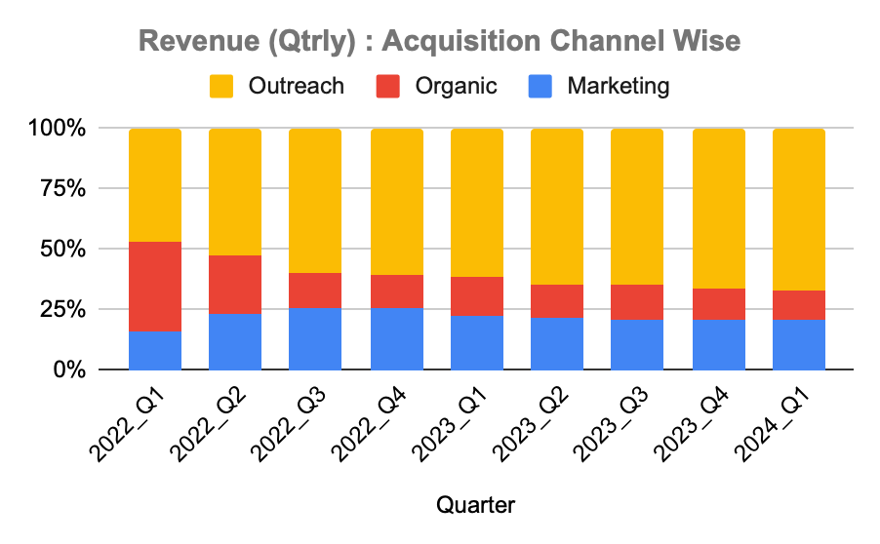
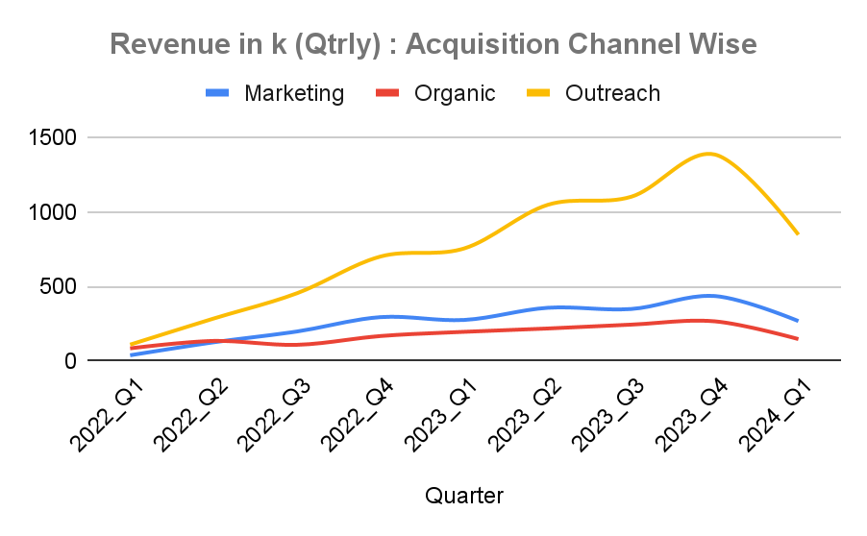
TRENDS: Channel
Assuming Outreach and Marketing incur significant cost for Bolt Business in terms of salaries for sales teams, expenses related to attending events, and costs for tools or software used in outreach activities. For Marketing, it can be advertising expenses, content creation, digital marketing campaigns, and analytics tools. Organic however is linked to Brand Value and Online Presence. (SEO etc)
Revenue from the Businesses acquired by Outreach has growth significantly and has 63% revenue Share. Recommend : Continue investing in Outreach efforts.
Whereas Revenue from Marketing has seen minor increase. Recommend: Optimise marketing Campaigns or adjust messaging.
Revenue from Organic channel has more or less stayed stagnant. Organic actually saw 20 pp drop in revenue in 2022 Q3. Data. On Deep dive this drop was mainly observed in Segment T4. (-46%). T3 saw 3 pp reduction. But T1 and T2 up by 375 pp and 96 pp respectively. T4 Revenue Overall went down by 24 pp during the Qtr. Solsticea only region which saw the drop in that quarter. Therefore could be region specific issue or T4 SEO optimisation.

Slide 11
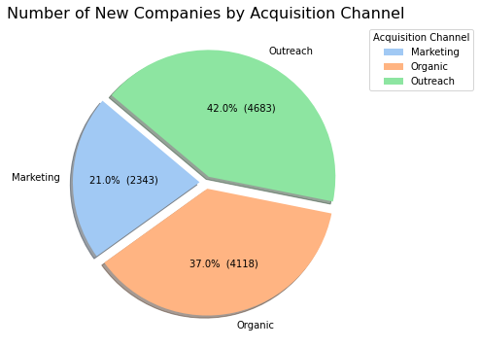
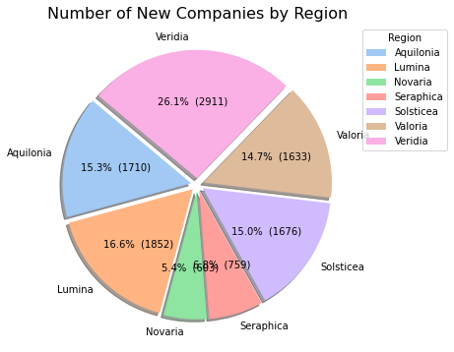
Tier Segment | # New Companies | %
T0 | 6 | 0.05%
T1 | 117 | 1.05%
T2 | 470 | 4.22%
T3 | 4192 | 37.62%
T4 | 6359 | 57.06%
Segment | Revenue Per Order | Revenue per Company
T0 | 4 | 6176
T1 | 4 | 1070
T2 | 5 | 397
T3 | 6 | 120
T4 | 11 | 43
Grand Total | 5 | 152

Slide 12
Recommendations
Segments | Segment Focus: Concentrate efforts on Segments T1, T2, and T3, with particular attention to T0 and T1 in Aquilonia. Pricing Adjustments: Reevaluate and adjust pricing strategies in regions where revenue per company is notably low.
Regions | Acquisition Strategy: Prioritize acquiring businesses that exhibit high performance in metrics such as Orders per Company, Revenue per Order, and Revenue per Company. Pay special attention to regions like Seraphica and Novaria, which show significant performance in specific factors, such as Aquilonia’s high Orders per Company but low Revenue per Order.
Channels | Outreach Investment: Maintain and potentially increase investment in Outreach efforts, which have proven effective and provide significant revenue impact. Marketing Optimization: Enhance marketing campaigns and refine messaging to boost performance and align with business goals. Organic Channel Investment: Given that the Organic channel incurs lower costs, focus on improving content quality and SEO to strengthen brand value. Deep Dive Analysis: Conduct a thorough analysis to determine if the decline in Organic revenue is related to regional issues (e.g., Solsticea) or specific SEO challenges in Segment T4.
Anomalies | Revenue Monitoring: Regularly track and analyze anomalies in Month-over-Month (MoM) and Quarter-over-Quarter (QoQ) revenue across segments, regions, and channels to address any fluctuations and optimize strategies accordingly.

Slide 13
Anomalies: Region
Period | Quarterly Increase
 | Aquilonia | Lumina | Novaria | Seraphica | Solsticea | Valoria | Veridia | Grand Total
2022_Q1
2022_Q2 | 120.86% | 244.47% | 5.50% | 335.00% | 82.44% | 303.73% | 134.02% | 136.27%
2022_Q3 | 27.44% | 71.99% | 127.91% | 352.87% | -35.33% | 80.41% | 39.19% | 40.07%
2022_Q4 | 34.19% | 67.36% | 94.16% | 177.65% | 93.67% | 43.51% | 43.16% | 52.98%
2023_Q1 | -0.43% | 15.02% | -10.84% | 69.66% | 14.80% | 2.00% | -0.08% | 5.44%
2023_Q2 | 14.98% | 40.08% | 65.67% | 79.21% | 22.75% | 26.70% | 32.90% | 32.43%
2023_Q3 | -19.52% | 26.87% | 40.32% | 37.03% | -30.59% | -16.64% | 23.97% | 4.46%
2023_Q4 | 6.93% | 22.74% | 26.97% | 25.99% | 62.54% | 14.46% | 26.21% | 23.17%
2024_Q1 | -32.49% | -32.40% | -40.69% | -39.45% | -48.22% | -52.17% | -36.12% | -39.62%

Slide 14
Anomalies: Segment
Period | Quartely Increase
 | T0 | T1 | T2 | T3 | T4 | Grand Total
2022_Q1
2022_Q2 | 82.98% | 214.65% | 283.77% | 125.58% | 70.39% | 136.27%
2022_Q3 | 28.56% | 69.59% | 76.98% | 43.64% | -29.82% | 40.07%
2022_Q4 | 54.29% | 42.89% | 52.54% | 58.87% | 50.13% | 52.98%
2023_Q1 | -11.46% | 5.32% | 3.22% | 11.91% | -2.72% | 5.44%
2023_Q2 | 26.90% | 27.38% | 37.24% | 34.33% | 25.85% | 32.43%
2023_Q3 | -53.79% | 2.78% | 22.41% | 2.50% | 19.09% | 4.46%
2023_Q4 | 24.05% | 3.88% | 13.42% | 34.29% | 38.54% | 23.17%
2024_Q1 | -31.10% | -38.18% | -40.93% | -38.21% | -48.32% | -39.62%

Slide 15
Anomalies: Channel
Period | Quartely Increase
 | Marketing | Organic | Outreach | Grand Total
2022_Q1
2022_Q2 | 234.78% | 59.72% | 161.50% | 136.27%
2022_Q3 | 58.48% | -19.51% | 60.01% | 40.07%
2022_Q4 | 48.92% | 54.96% | 54.28% | 52.98%
2023_Q1 | -6.48% | 16.92% | 7.71% | 5.44%
2023_Q2 | 29.77% | 11.48% | 38.80% | 32.43%
2023_Q3 | -2.27% | 11.98% | 5.19% | 4.46%
2023_Q4 | 24.96% | 9.08% | 25.71% | 23.17%
2024_Q1 | -38.66% | -45.02% | -38.88% | -39.62%

Slide 16
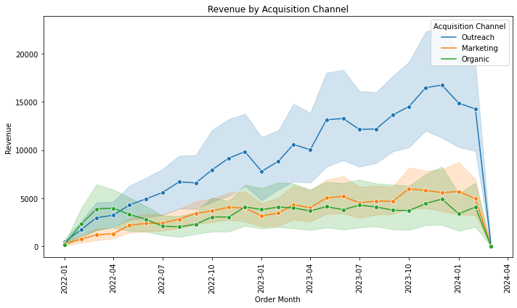
Trends

Slide 17
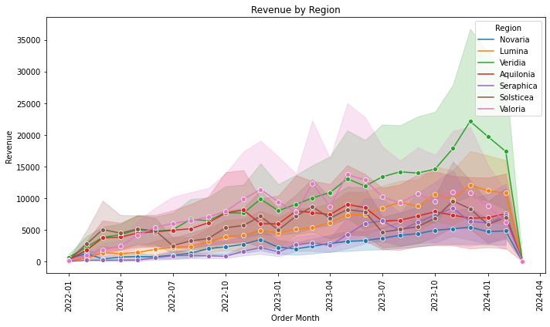
Trends

Slide 18
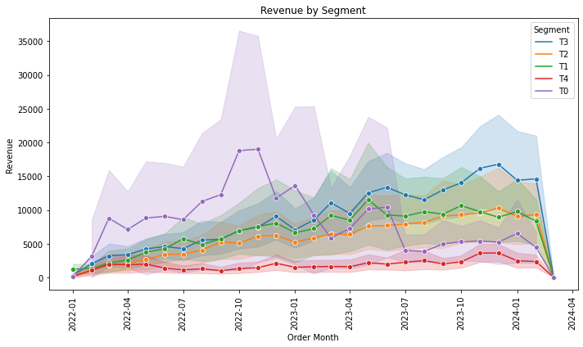
Trends

Slide 19
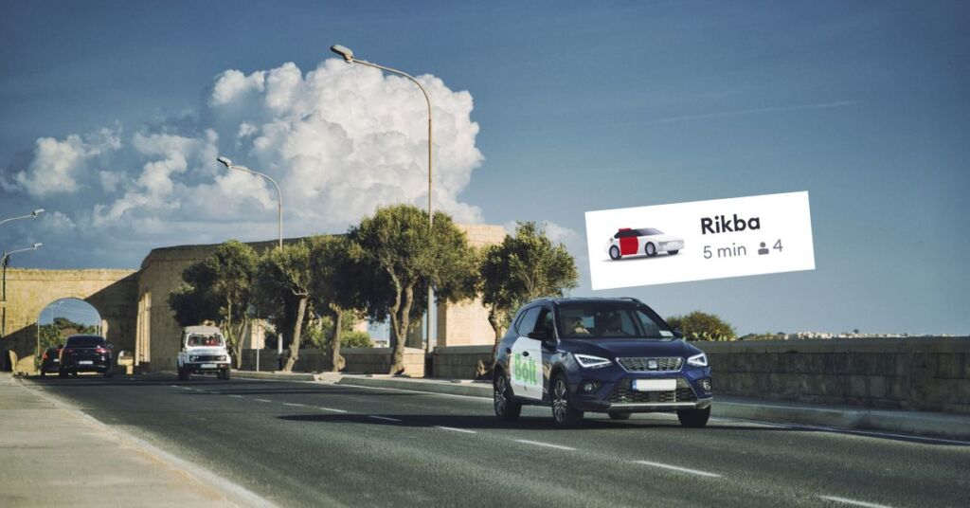
Part 2 (ETL Process)

Slide 20
Explanation and Assumption
Aggregate Orders Table at right level.
Left join Countries with Users (since Same Company users can be in different Countries)
Assuming No Ride Sharing
Just to Answer (3) How many companies signed up we are left joining aggregate table with companies. *
*Here assumed that some companies can have zero orders but since the question asks how many companies signed up. In order to compute this we have taken company as left table.
We dont need orders try table as completed orders are required to answer the queries. We also grouped by admin_id in our agg table and later joined it with company table . Any change in names of companies will be accounted for.

Slide 21

Orders
company
Final Columns: (Checkout SQL in Next Slide)
month_of_order, ( From order created at)
week_of_order,
company_admin_id,
c.name as company_name, (From Companies Table)
user_id, (From Orders Table)
country_name,
region,
Revenue,
orders,
date_of_order
order_id
user_id
Revenue created_at
admin_id name created_at
users
Aggregate Table
user_id
country_code
countries
Unified Table
code
name
region

Slide 22
ETL Pipeline (SQL Query)
with companies as (
select cast(created_at as date) as company_created_at,
admin_id, name
from company
)
, orders_agg as (
Select
month(cast(created_at as date)) as month_of_order,
week(cast(created_at as date)) as week_of_order,
cast(created_at as date) as date_of_order,
com.admin_id as company_admin_id
o.user_id,
c.name as country_name,
c.region as region,
sum(o.Revenue) as Revenue,
count(o.order_id) as orders
From orders o
left join company com on com.admin_id = o.admin_id
left join users u on o.user_id = u.user_id
left join countries c on c.code = u.country_code
group by 1,2,3,4,5,6,7
)
select
month_of_order,
week_of_order,
c.admin_id,
c.name as company_name,,
user_id,
country_name,
region,
Revenue,
orders,
date_of_order
from companies c
left join orders_agg oa on oa.company_admin_id = c.admin_id
WITH ( format = 'PARQUET', partitioned_by = ARRAY[‘date_of_order’] );

Slide 23
Queries
1. Daily/ Weekly/ Monthly Dynamic of Revenue, Orders per country, region.
Sol:
For E.g. Monthly Level Query will be as follows:
select month_of_order, country_name, region,
sum(Revenue) as Revenue, sum(orders) as orders
from Unified_table
group by 1,2,3
3. How many companies signed up ?
Sol:
select distinct admin_id from Unified_table
Please note this will give all company ids which have ride or not from its users. In order to find only those with some rides we can filter for orders not null.
2. Top 10 companies based on no. of Orders last week.
Sol:
select company_name, sum(orders)
from Unified_table
where date_of_order between current_date( ) - interval ‘7’ day and current_date( )
group by 1
order by 2 desc
limit 10 2. Monthly Active Users.
Sol: Since our table is at User level we just need to check if user did any ride and group by month
Select year(date_of_order), month_of_order, count(distinct user_id) as monthly_active
from Unified_Table
group by 1,2

Slide 24
Part 3
(Data Discovery & Feature Design)

Slide 25
Introduction
Bolt's Delivery vertical is a three-sided marketplace that connects customers, restaurants and couriers.
Couriers travel to restaurants to pick up orders prepared by the restaurant. After the restaurant finishes preparation and the courier picks up the order, the courier travels to the customer to deliver the order.
GOAL: Eliminate wasted time for the courier and have orders delivered to customers faster and on time, while the food is warm. Faster food Delivery leads to better user satisfaction and food gets delivered warm.
Next we look at how can we:
Compute the time spent by Bolt Courier at Different stages.
Identify the largest time spent.
Propose feature and its validation metrics to solve the problem.
Background
Methodology

Slide 26
Calculations & Visualization

Slide 27

Courier Journey
Stages
0. Order_proposed_to_courier
courie r_accepts_order
courier_arrived_at_restaurant
courier_picked_up_order
courier_arrived_at_customer
courier_delivered_order
2
1
3
5
4

Slide 28
Mean Time Taken (in Sec)
1
Courier Accepts Order : 11 s
2
Arrives at restaurant: 269 s
3
picks up order : 283 s
4
arrives at customer 690s
5
Delivers the order: 131s
Link to the Data

Slide 29
Key Finding
1505
3039
64k
1
Restaurant ids
Courier
Number of Orders
City : Bucharest
400
2400
5.6 kmph
12.6 kmph
Mean distance to Restaurant
Mean Distance to Customer
Speed to arrive at Restaurant
Speed to reach Customer

Slide 30
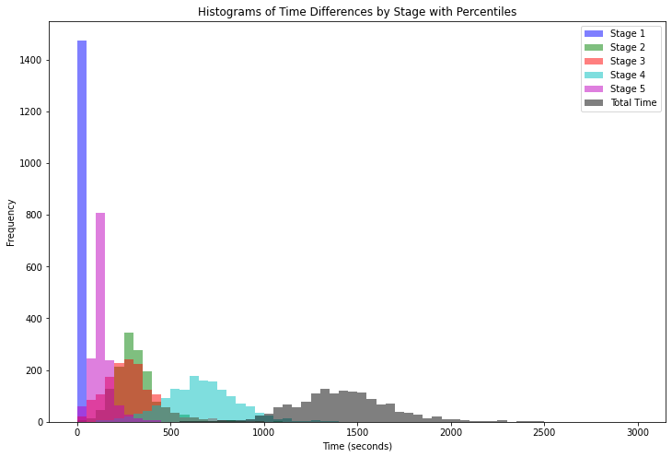
Distribution (Mean time taken at Restaurant Level)

Slide 31
Feature 1 : Pickup Optimization
Pain Points | Based on the data, the reported meal prepared finish time was found to be 45 minutes before the Courier arrival time. But Courier is still waiting 283 s ~ 5 mins to pickup the order. This can be due to many reasons: like unable to find Parking, Restaurant packaging issue, Meal not yet prepared etc. Further splitting down this time is Recommended to see where is the largest scope lies.
Objective | Optimize the pickup time by sending more accurate estimated order ready time to the Courier in the app. Because although meal is getting prepared early but issue can be that order is getting dispatched much later from the restaurant. Based on historical data on average meal prep times for each restaurant. We can build a scaling model for each restaurant based on which we can notify the Courier on when the order will be ready. So that once they reach the location they don’t have to wait for the order dispatch.
Experimentation & Metrics | Split the Couriers into 2 segments: Control: Couriers get the estimated time on the app based on when the restaurant finishes meal prep. Treatment: Courier get the estimated time scaled by a factor depending on which restaurant order is made from. Note: In order to compute the scale factor we might need to analyze the historical data. [Segmentation]
Metrics | P0: Courier Wait time at Restaurant. P1: Total Order Delivery Time Combining all the stages. Can Add more depending on business needs.

Slide 32
Feature 1 : Dynamic Notification
Data Points | Based on the finding Courier generally drive slow (50% speed) when picking up the orders as compared to when delivering the order. This might be due to: 1. General Behaviour 2. Or the way incentive structure is designed at Bolt which only incentivizes based on time taken to deliver post pickup. Or just
Objective | Notify Couriers nudging them to pick up faster and this encourage couriers to maintain a consistent speed for both pickup and delivery, thereby reducing overall delivery time.
Experimentation & Metrics | Split the Couriers into 2 segments: Control: Couriers don’t get the notification on the app once they accept the order. Treatment: Courier get the notification on the app once they accept the order. Monitor WoW for both the groups
Metrics | P0: Avg Pickup Time
Remarks | General Reminder Message: "Quick reminder: Fast pickups mean happier customers and bigger bonuses! Keep up the great work!" Incentive Highlight Message: "Earn extra bonuses for quick pickups! Your average pickup time is improving. Let's keep it up!"

Slide 33
Question Time!
Part 1
Part 2
Part 3

